Slide 1
Foundations of Machine Learning
Module 3: Instance Based Learning and Feature Selection
Part D: Instance Based Learning
Sudeshna Sarkar
IIT Kharagpur

Slide 2
Instance-Based Learning
One way of solving tasks of approximating discrete or real valued target functions
Have training examples: (x_{n}, f(x_{n})), n=1..N.
Key idea:
just store the training examples
when a test example is given then find the closest matches

Slide 3
Inductive Assumption
Similar inputs map to similar outputs
If not true => learning is impossible
If true => learning reduces to defining “similar”
Not all similarities created equal
predicting a person’s weight may depend on different attributes than predicting their IQ

Slide 4
Basic k-nearest neighbor classification
Training method:
Save the training examples
At prediction time:
Find the k training examples (x₁,y₁),…(x_{k},y_{k}) that are closest to the test example x
Predict the most frequent class among those y_{i}’s.
Example: http://cgm.cs.mcgill.ca/~soss/cs644/projects/simard/

Slide 5
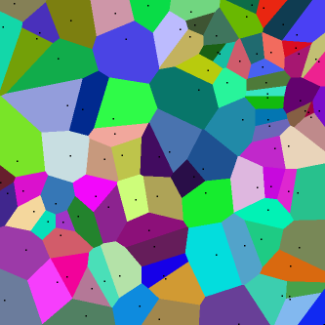
What is the decision boundary?
Voronoi diagram

Slide 6
Basic k-nearest neighbor classification
Training method:
Save the training examples
At prediction time:
Find the k training examples (x₁,y₁),…(x_{k},y_{k}) that are closest to the test example x
Predict the most frequent class among those y_{i}’s.
Improvements:
Weighting examples from the neighborhood
Measuring “closeness”
Finding “close” examples in a large training set quickly

Slide 7
k-Nearest Neighbor
Average of k points more reliable when:
noise in attributes
noise in class labels
classes partially overlap
o
+
o
o
o
o
o
o
o
o
o
+
+
attribute_2
o
o
o
o
+
+
+
+
+
+
+
+
+
attribute_1

Slide 8
How to choose “k”
Large k:
less sensitive to noise (particularly class noise)
better probability estimates for discrete classes
larger training sets allow larger values of k
Small k:
captures fine structure of problem space better
may be necessary with small training sets
Balance must be struck between large and small k
As training set approaches infinity, and k grows large, kNN becomes Bayes optimal

Slide 9
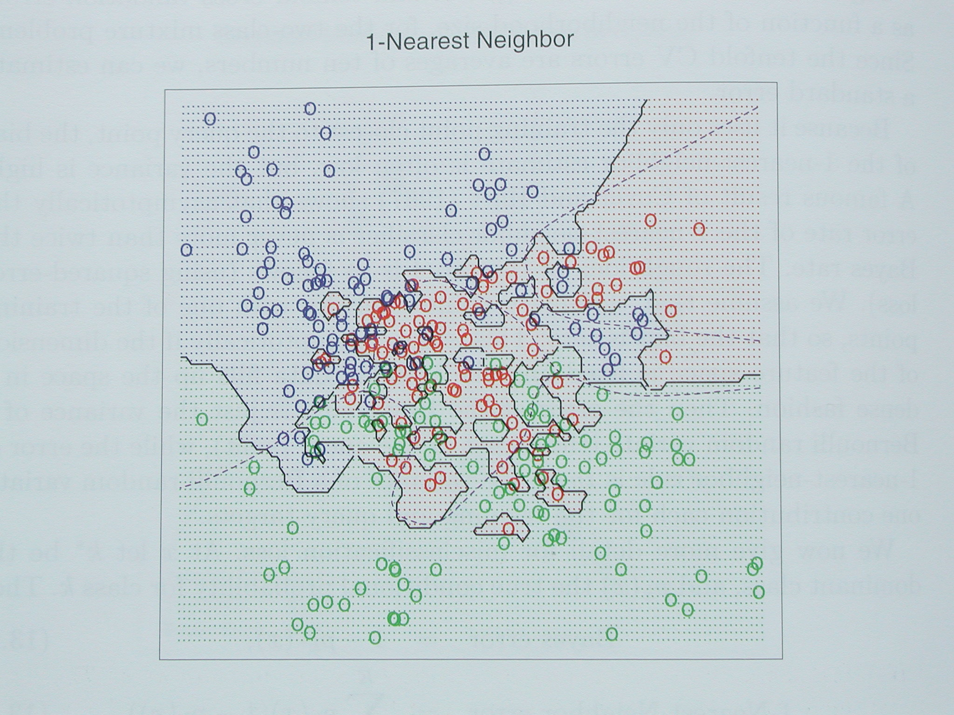
From Hastie, Tibshirani, Friedman 2001 p418

Slide 10
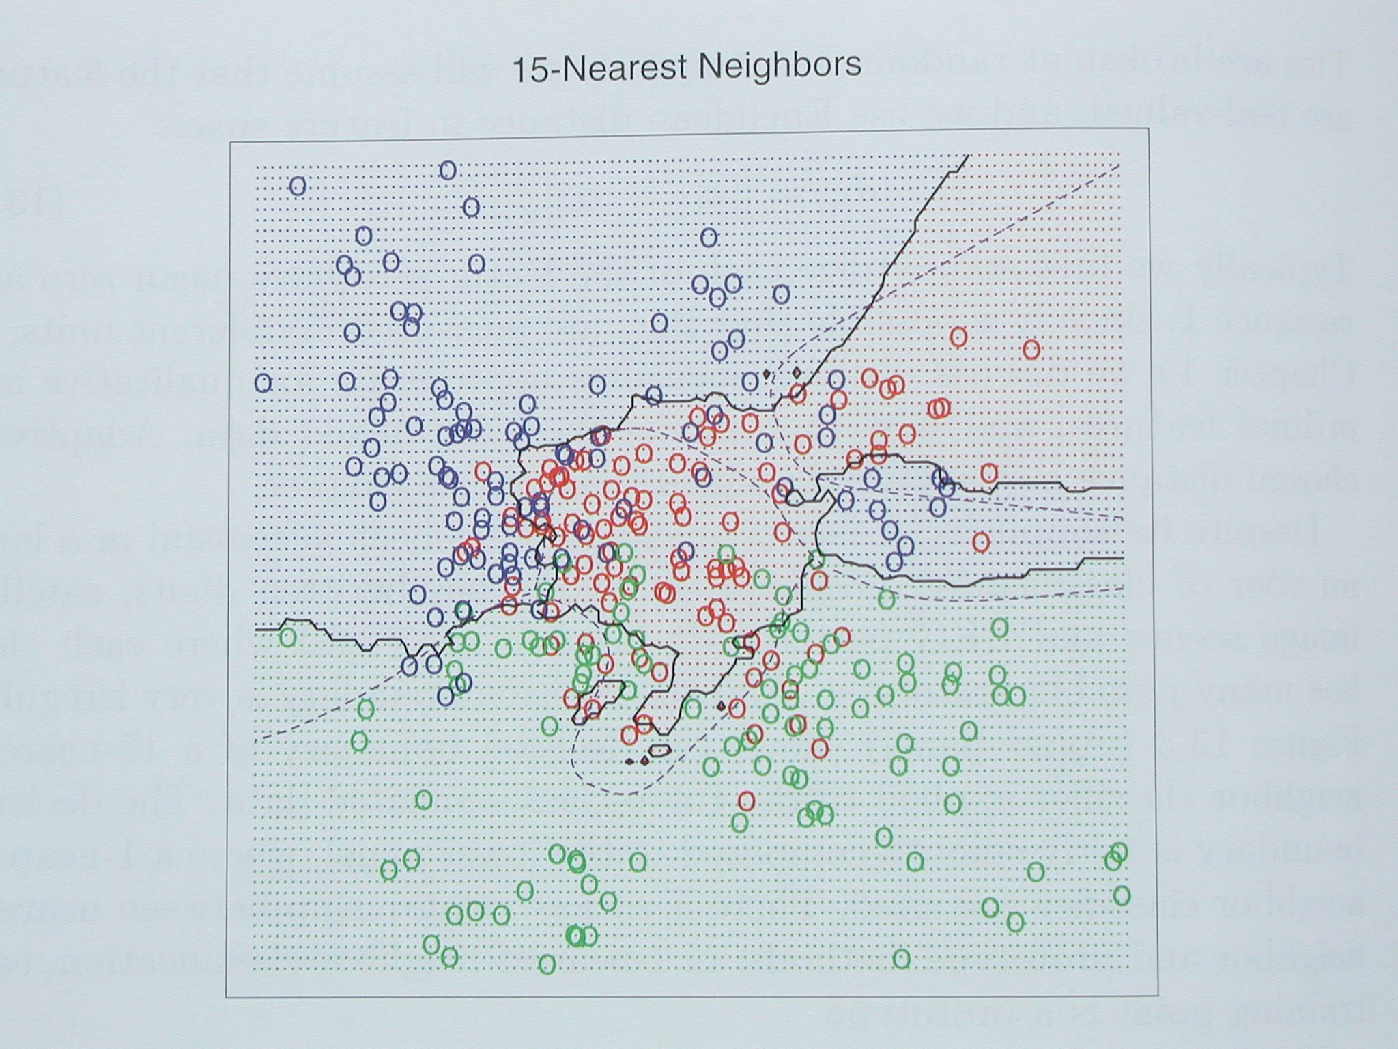
From Hastie, Tibshirani, Friedman 2001 p418

Slide 11
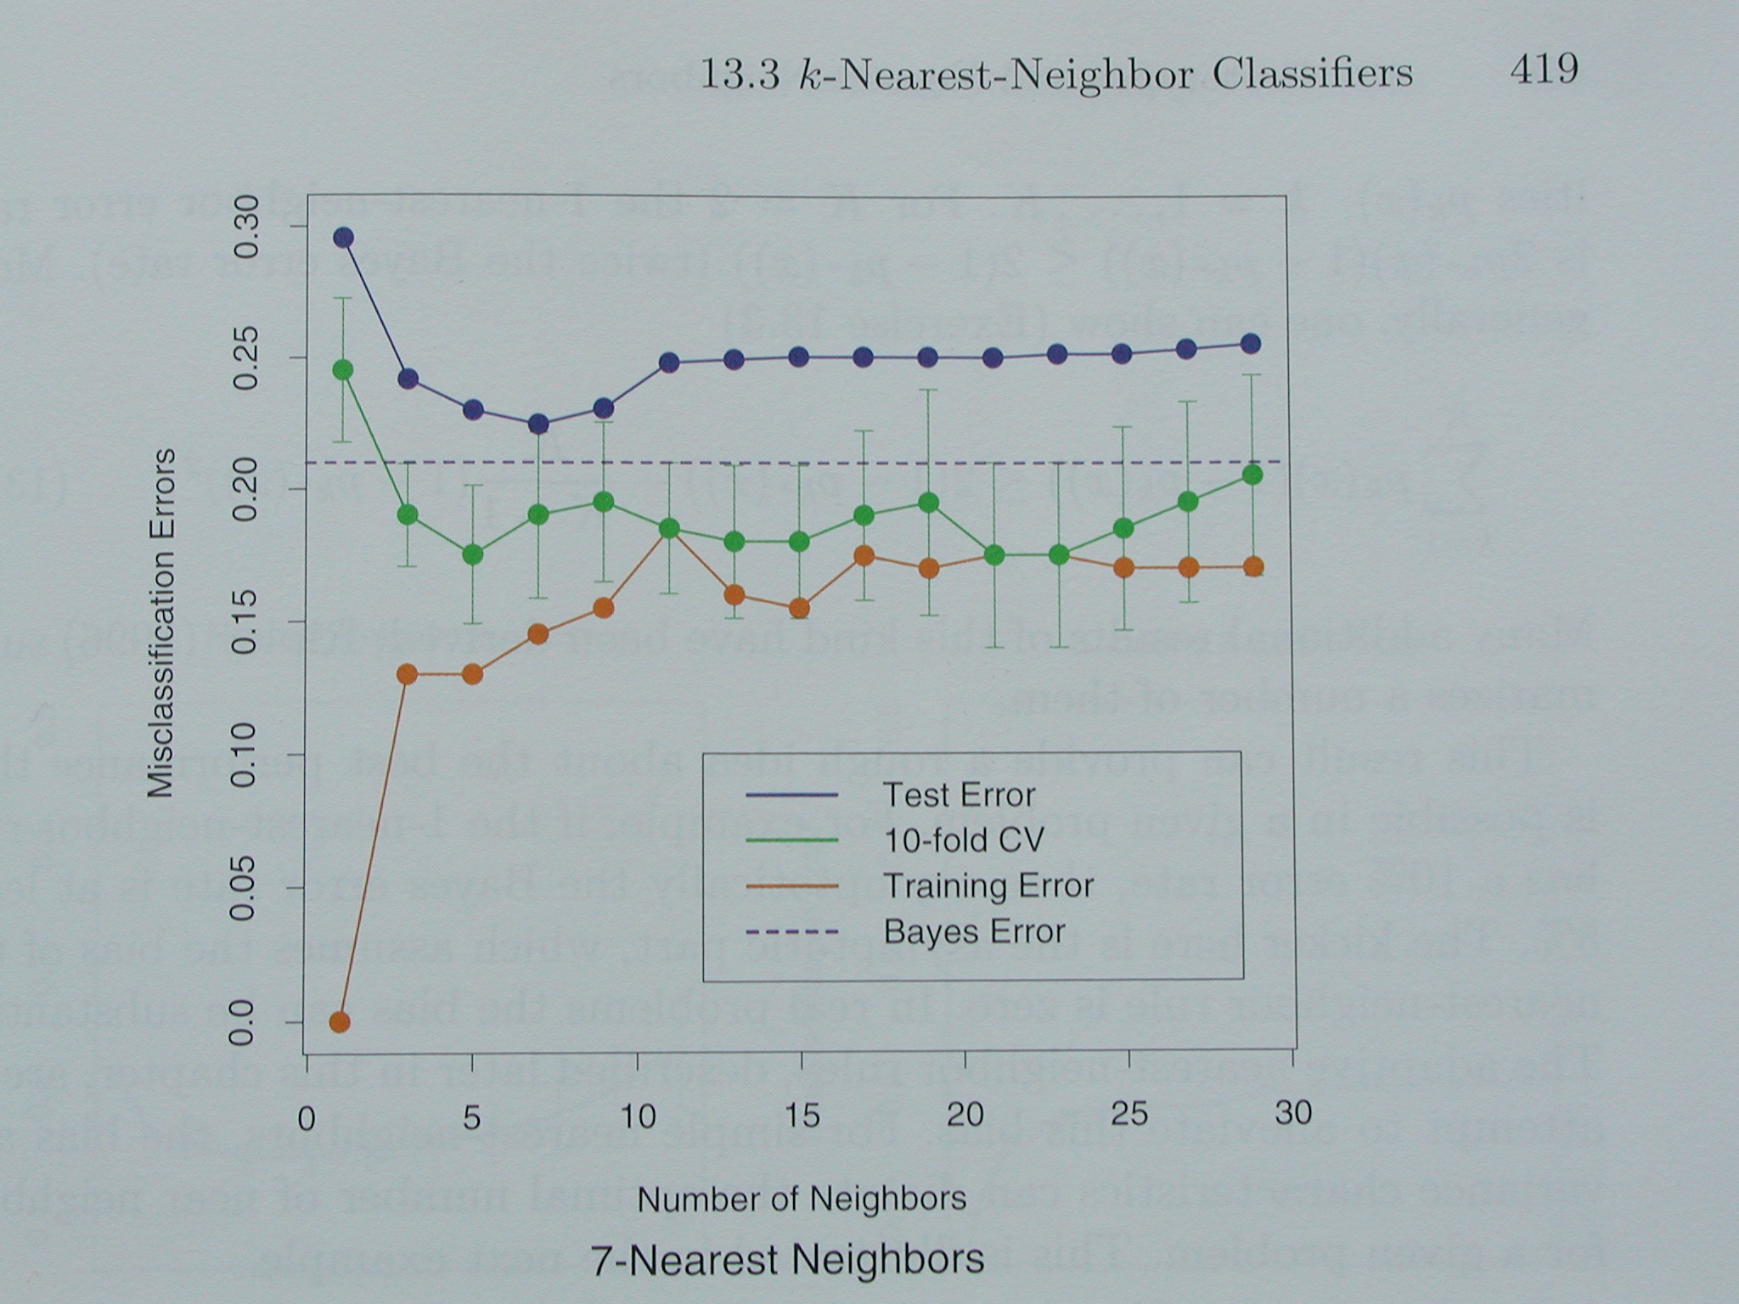
From Hastie, Tibshirani, Friedman 2001 p419

Slide 12
Distance-Weighted kNN
tradeoff between small and large k can be difficult
use large k, but more emphasis on nearer neighbors?

Slide 13
Locally Weighted Averaging
Let k = number of training points
Let weight fall-off rapidly with distance
KernelWidth controls size of neighborhood that has large effect on value (analogous to k)

Slide 14
Locally Weighted Regression
All algs so far are strict averagers: interpolate, but can’t extrapolate
Do weighted regression, centered at test point, weight controlled by distance and KernelWidth
Local regressor can be linear, quadratic, n-th degree polynomial, neural net, …
Yields piecewise approximation to surface that typically is more complex than local regressor

Slide 15
Euclidean Distance
gives all attributes equal weight?
only if scale of attributes and differences are similar
scale attributes to equal range or equal variance
assumes spherical classes
o
o
o
o
o
o
o
o
o
o
attribute_2
+
o
+
+
+
+
+
+
+
+
attribute_1

Slide 16
Euclidean Distance?
o
+
o
o
o
o
o
o
o
+
o
o
o
+
o
o
+
o
+
o
attribute_2
o
attribute_2
o
+
+
o
+
+
+
o
+
+
+
+
+
o
+
o
o
+
+
o
+
attribute_1
attribute_1
if classes are not spherical?
if some attributes are more/less important than other attributes?
if some attributes have more/less noise in them than other attributes?

Slide 17
Weighted Euclidean Distance
large weights => attribute is more important
small weights => attribute is less important
zero weights => attribute doesn’t matter
Weights allow kNN to be effective with axis-parallel elliptical classes
Where do weights come from?

Slide 18
Curse of Dimensionality
as number of dimensions increases, distance between points becomes larger and more uniform
if number of relevant attributes is fixed, increasing the number of less relevant attributes may swamp distance
when more irrelevant than relevant dimensions, distance becomes less reliable
solutions: larger k or KernelWidth, feature selection, feature weights, more complex distance functions

Slide 19
K-NN and irrelevant features
+
+
+
o
?
o
o
o
o
o
+
+
o
+
o
o
o
o
o
+
o
o
o
o
o
o
+

Slide 20
K-NN and irrelevant features
+
o
+
?
o
o
o
+
o
o
o
o
o
o
+
o
+
+
+
o
o
+
o
o
o
o
o

Slide 21
K-NN and irrelevant features
+
o
+
?
o
o
o
+
o
o
o
o
+
o
o
o
+
o
+
o
+
o
+
o
o
o
o

Slide 22
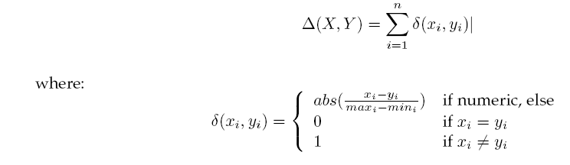
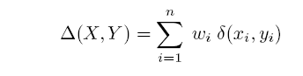
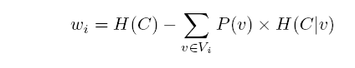
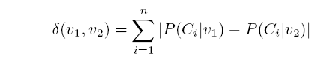
Ways of rescaling for KNN
Normalized L1 distance:
Scale by IG:
Modified value distance metric:

Slide 23
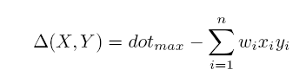
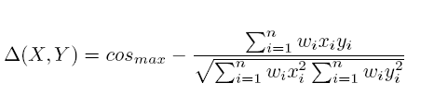


Ways of rescaling for KNN
Dot product:
Cosine distance:
TFIDF weights for text: for doc j, feature i: x_{i}=tf_{i,j} * idf_{i} :
#docs in corpus
#occur. of term i in doc j
#docs in corpus that contain term i

Slide 24
Combining distances to neighbors
Standard KNN:
Distance-weighted KNN:

Slide 25
Advantages of Memory-Based Methods
Lazy learning: don’t do any work until you know what you want to predict (and from what variables!)
never need to learn a global model
many simple local models taken together can represent a more complex global model
better focussed learning
handles missing values, time varying distributions, ...
Very efficient cross-validation
Intelligible learning method to many users
Nearest neighbors support explanation and training
Can use any distance metric: string-edit distance, …

Slide 26
Weaknesses of Memory-Based Methods
Curse of Dimensionality:
often works best with 25 or fewer dimensions
Run-time cost scales with training set size
Large training sets will not fit in memory
Many MBL methods are strict averagers
Sometimes doesn’t seem to perform as well as other methods such as neural nets
Predicted values for regression not continuous

